Slide 1
Agenda
The Twelve-Factor App
What is Twelve-Factor App?
The Twelve-Factors
Benefits of Twelve-Factor App

Slide 2
What is Twelve-Factor App?
The Twelve-Factor App methodology was created by Adam Wiggins and engineers at Heroku while building Heroku platform.
First presented by Adam Wiggins in 2011.
Later due to their generic and platform independent implementation they are released as fundamental guidelines for any cloud ready application.
Include defined practices around version control, environment configuration, isolated dependencies, executing apps as stateless resources, working with backing services like database, queue, and much more.
Notes:
Heroku was acquired by Salesforce.com in 2010.

Slide 3
The Twelve-Factors
I. Codebase
II. Dependencies
III. Config
IV. Backing services
V. Build, Release run
VI. Processes
VII. Port binding
VIII. Concurrency
IX. Disposability
X. Dev/prod parity
XI. Logs
XII. Admin processes

Slide 4
1. Codebase
One Codebase Many Deploy

Slide 5
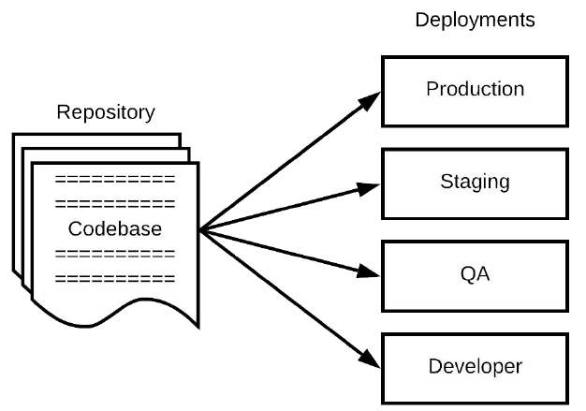
Codebase
An app codebase must be stored in a repository managed by a VCS such as Git.
Must be 1-to-1 correlation between the codebase and the app.
A distributed app can have multiple codebases, one for each distributed module.
Multiple apps cannot share code. Such code must be factored out as shared libraries
Notes:
Codebase - The source code for the application that will be compile or interpreted before execution.
Repository (repo) - Codebase managed within a VCS (Version Control System) system.
Deploy - An installation of the app with a specific configuration for a specific use case and/or audience.

Slide 6
2. Dependencies
Explicitly Declare and Isolate

Slide 7
Dependencies
Declare dependencies along with their specific versions (if required) in a manifest like package.json in npm.
Use dependency isolation tool to prevent accidental import of unwantead dependencies.
Use dependency manager i.e. packaging system like nuget or npm to fetch all required dependencies from their sources and maintain them in a local repository.
Notes:
Dependency Ü Any library module used by the app which
is either developed/managed by the developer or by a 3rd
party vendor requires. A dependency is identified by its
name, version, vendor, and download source.
Dependency Manifest Ü A document within the codebase
that lists all the dependencies for the app. E.g. pom.xml,
build.gradle, gemfile, etc.
Dependency Manager Ü A separate module which is part
of the build toolchain that processes the dependency
manifest, manages and download all the required
dependencies from their sources before the codebase is
taken to the compilation. E.g. Maven, Gradle, PIP, etc.
Dependency Isolation Ü A separate module which is part
of the build toolchain which provides dependencies
isolation for each app within an environment such that a
dependency within an isolation (virtual environment)
cannot be used by another app from the other isolation.
E.g. Virtualenv, etc.

Slide 8
3. Config
Store Config in the Environment

Slide 9
Config
A 12-factor app requires strict separation of config and code.
Config is not checked into the app’s repository.
A config contains secrets such as passwords, or db connection strings
config should be stored in environment variables.
App packaging, containerization runtimes, and orchestration systems provides facility to define config for the app thru environment variables based on the deploy type.
Notes:
Dependency Ü Any library module used by the app which
is either developed/managed by the developer or by a 3rd
party vendor requires. A dependency is identified by its
name, version, vendor, and download source.
Dependency Manifest Ü A document within the codebase
that lists all the dependencies for the app. E.g. pom.xml,
build.gradle, gemfile, etc.
Dependency Manager Ü A separate module which is part
of the build toolchain that processes the dependency
manifest, manages and download all the required
dependencies from their sources before the codebase is
taken to the compilation. E.g. Maven, Gradle, PIP, etc.
Dependency Isolation Ü A separate module which is part
of the build toolchain which provides dependencies
isolation for each app within an environment such that a
dependency within an isolation (virtual environment)
cannot be used by another app from the other isolation.
E.g. Virtualenv, etc.

Slide 10
4. Backing Services
Treat backing services as attached resources

Slide 11
Backing Services
Backing services are treated as attached resources, whether they are locally managed or third party services.
They can be accessed easily via a URL or other credentials, and even they can swap to each other.
Backing Services Examples are:
  Data Store
  SMTP
  Caching Systems
  Azure Storage
Notes:
Dependency Ü Any library module used by the app which
is either developed/managed by the developer or by a 3rd
party vendor requires. A dependency is identified by its
name, version, vendor, and download source.
Dependency Manifest Ü A document within the codebase
that lists all the dependencies for the app. E.g. pom.xml,
build.gradle, gemfile, etc.
Dependency Manager Ü A separate module which is part
of the build toolchain that processes the dependency
manifest, manages and download all the required
dependencies from their sources before the codebase is
taken to the compilation. E.g. Maven, Gradle, PIP, etc.
Dependency Isolation Ü A separate module which is part
of the build toolchain which provides dependencies
isolation for each app within an environment such that a
dependency within an isolation (virtual environment)
cannot be used by another app from the other isolation.
E.g. Virtualenv, etc.

Slide 12
5. Build, Release and Run
Strictly separate build and run stages

Slide 13
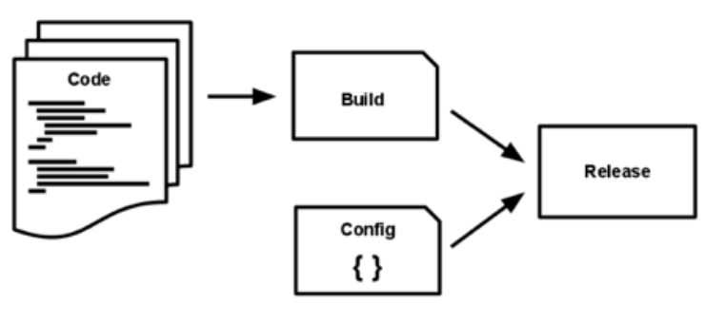
Build, Release and Run
BUILD = codebase + dependencies + assets
RELEASE = BUILD + config
RUN = run process against RELEASE
There must be a separate pipeline for build and release process.
The “run” can run multiple times from the same “release” on the environment.
Also, the “release” can run multiple times from the same “build” with different configs.
Notes:
Dependency Ü Any library module used by the app which
is either developed/managed by the developer or by a 3rd
party vendor requires. A dependency is identified by its
name, version, vendor, and download source.
Dependency Manifest Ü A document within the codebase
that lists all the dependencies for the app. E.g. pom.xml,
build.gradle, gemfile, etc.
Dependency Manager Ü A separate module which is part
of the build toolchain that processes the dependency
manifest, manages and download all the required
dependencies from their sources before the codebase is
taken to the compilation. E.g. Maven, Gradle, PIP, etc.
Dependency Isolation Ü A separate module which is part
of the build toolchain which provides dependencies
isolation for each app within an environment such that a
dependency within an isolation (virtual environment)
cannot be used by another app from the other isolation.
E.g. Virtualenv, etc.

Slide 14
6. Processes
Execute the app as one or more stateless processes

Slide 15
Processes
An app process(es) must be designed to run stateless and share nothing.
Any state that requires persistent must be handled by the backing services (e.g. database).
The idea of stateless services, help us to scale them by creating multiple instances.
App should save the sessions in a database rather than holding it in its memory.
Notes:
Dependency Ü Any library module used by the app which
is either developed/managed by the developer or by a 3rd
party vendor requires. A dependency is identified by its
name, version, vendor, and download source.
Dependency Manifest Ü A document within the codebase
that lists all the dependencies for the app. E.g. pom.xml,
build.gradle, gemfile, etc.
Dependency Manager Ü A separate module which is part
of the build toolchain that processes the dependency
manifest, manages and download all the required
dependencies from their sources before the codebase is
taken to the compilation. E.g. Maven, Gradle, PIP, etc.
Dependency Isolation Ü A separate module which is part
of the build toolchain which provides dependencies
isolation for each app within an environment such that a
dependency within an isolation (virtual environment)
cannot be used by another app from the other isolation.
E.g. Virtualenv, etc.

Slide 16
7. Port Binding
Export services via port binding

Slide 17
Port Binding
An app should be fully self-contained; means it does not requires runtime injection of a web server/container.
An app should only bind to a TCP/UDP port rather than the complete address set i.e. IP address and TCP/UDP port.
An app port binding should be configurable; not hard coded in the codebase.
Apps with port binding bring flexibility of getting run within the same environment where all the other processes are bind to different unique ports.
Notes:
Dependency Ü Any library module used by the app which
is either developed/managed by the developer or by a 3rd
party vendor requires. A dependency is identified by its
name, version, vendor, and download source.
Dependency Manifest Ü A document within the codebase
that lists all the dependencies for the app. E.g. pom.xml,
build.gradle, gemfile, etc.
Dependency Manager Ü A separate module which is part
of the build toolchain that processes the dependency
manifest, manages and download all the required
dependencies from their sources before the codebase is
taken to the compilation. E.g. Maven, Gradle, PIP, etc.
Dependency Isolation Ü A separate module which is part
of the build toolchain which provides dependencies
isolation for each app within an environment such that a
dependency within an isolation (virtual environment)
cannot be used by another app from the other isolation.
E.g. Virtualenv, etc.

Slide 18
8. Concurrency
Scale out via the process model

Slide 19
Concurrency
To ensure the scalability of an app, more copies of the app (processes) should be deployed rather than making the app larger.
The share-nothing, horizontal partitioning nature of twelve-factor app processes means that adding more concurrency is a simple and reliable operation.
Tools such as Kubernetes can really help you here.
Notes:
Dependency Ü Any library module used by the app which
is either developed/managed by the developer or by a 3rd
party vendor requires. A dependency is identified by its
name, version, vendor, and download source.
Dependency Manifest Ü A document within the codebase
that lists all the dependencies for the app. E.g. pom.xml,
build.gradle, gemfile, etc.
Dependency Manager Ü A separate module which is part
of the build toolchain that processes the dependency
manifest, manages and download all the required
dependencies from their sources before the codebase is
taken to the compilation. E.g. Maven, Gradle, PIP, etc.
Dependency Isolation Ü A separate module which is part
of the build toolchain which provides dependencies
isolation for each app within an environment such that a
dependency within an isolation (virtual environment)
cannot be used by another app from the other isolation.
E.g. Virtualenv, etc.

Slide 20
9. Disposability
Maximize robustness with fast startup and graceful shutdown

Slide 21
Disposability
An app process should be design in a way that it can be tear down, terminated, and restart again in moments.
An app process should have minimum startup time.
An app process should shut down gracefully on terminate signal.
An app process should also be robust against sudden failure, and should be architect to handle unexpected, non-graceful termination without losing the in progress workload requests.
Notes:
Dependency Ü Any library module used by the app which
is either developed/managed by the developer or by a 3rd
party vendor requires. A dependency is identified by its
name, version, vendor, and download source.
Dependency Manifest Ü A document within the codebase
that lists all the dependencies for the app. E.g. pom.xml,
build.gradle, gemfile, etc.
Dependency Manager Ü A separate module which is part
of the build toolchain that processes the dependency
manifest, manages and download all the required
dependencies from their sources before the codebase is
taken to the compilation. E.g. Maven, Gradle, PIP, etc.
Dependency Isolation Ü A separate module which is part
of the build toolchain which provides dependencies
isolation for each app within an environment such that a
dependency within an isolation (virtual environment)
cannot be used by another app from the other isolation.
E.g. Virtualenv, etc.

Slide 22
10. Dev/Prod Parity
Keep development, staging, and production as similar as possible

Slide 23
Dev/Prod Parity
An app’s engineering process should be design to support CI/CD.
The engineering process should minimize the dev and prod gap.
Keeping dev, staging and prod similar will ensure anyone can understand it and provide releases.
This ensures great development with limited errors, and also enables better scalability.
Notes:
Dependency Ü Any library module used by the app which
is either developed/managed by the developer or by a 3rd
party vendor requires. A dependency is identified by its
name, version, vendor, and download source.
Dependency Manifest Ü A document within the codebase
that lists all the dependencies for the app. E.g. pom.xml,
build.gradle, gemfile, etc.
Dependency Manager Ü A separate module which is part
of the build toolchain that processes the dependency
manifest, manages and download all the required
dependencies from their sources before the codebase is
taken to the compilation. E.g. Maven, Gradle, PIP, etc.
Dependency Isolation Ü A separate module which is part
of the build toolchain which provides dependencies
isolation for each app within an environment such that a
dependency within an isolation (virtual environment)
cannot be used by another app from the other isolation.
E.g. Virtualenv, etc.

Slide 24
11. Logs
Treat logs as event streams

Slide 25
Logs
Logs provide visibility into the behavior of a running app.
An app should write its logs to its output stream that should be configurable from the environment.
Don’t route or store logs in files.
Use Splunk or Logstash/ELK Stack for logging.
Notes:
Dependency Ü Any library module used by the app which
is either developed/managed by the developer or by a 3rd
party vendor requires. A dependency is identified by its
name, version, vendor, and download source.
Dependency Manifest Ü A document within the codebase
that lists all the dependencies for the app. E.g. pom.xml,
build.gradle, gemfile, etc.
Dependency Manager Ü A separate module which is part
of the build toolchain that processes the dependency
manifest, manages and download all the required
dependencies from their sources before the codebase is
taken to the compilation. E.g. Maven, Gradle, PIP, etc.
Dependency Isolation Ü A separate module which is part
of the build toolchain which provides dependencies
isolation for each app within an environment such that a
dependency within an isolation (virtual environment)
cannot be used by another app from the other isolation.
E.g. Virtualenv, etc.

Slide 26
12. Admin Processes
Run admin/management tasks as one-off processes

Slide 27
Admin Processes
An app often comes with various one-off administrative processes for maintenance tasks like cleaning temporary or unused or malformed data etc.
Admin tasks should run as separate process(es) against the same release. Hence any failure either in admin process or app's own process do not impact each other.
Admin code must ship with application code to avoid sync issues.
Notes:
Dependency Ü Any library module used by the app which
is either developed/managed by the developer or by a 3rd
party vendor requires. A dependency is identified by its
name, version, vendor, and download source.
Dependency Manifest Ü A document within the codebase
that lists all the dependencies for the app. E.g. pom.xml,
build.gradle, gemfile, etc.
Dependency Manager Ü A separate module which is part
of the build toolchain that processes the dependency
manifest, manages and download all the required
dependencies from their sources before the codebase is
taken to the compilation. E.g. Maven, Gradle, PIP, etc.
Dependency Isolation Ü A separate module which is part
of the build toolchain which provides dependencies
isolation for each app within an environment such that a
dependency within an isolation (virtual environment)
cannot be used by another app from the other isolation.
E.g. Virtualenv, etc.

Slide 28
Benefits of Twelve-Factor App
Use declarative formats for setup automation. This minimizes the time and cost for new developers joining the project
Have a clean contract with the underlying operating system, offering maximum portability between execution environments
Suitable for deployment on modern cloud platforms, thus removing the need for servers and systems administration
Limits differences between development and production, enabling continuous deployment for maximum agility
Can scale up without any major changes to tooling, architecture, or development practices, hence performance is a priority
Notes:
Ensures scalability and resilience (Recovery) to the design
You will get enormous scalability and resilience capabilities without actually doing any explicit development for that.
Ease in system maintenance
You will get several advantages in system maintenance by utilizing various tools and software that provides automation in testing, delivery, deployment, monitoring, and reporting, making software maintenance an easy job.
Helps avoid the cost of software erosion
You will be able to make quicker and periodic maintenance on your app that includes adding new features, changes.

